Slide 1
CS M51A Discussion #4
Hyunjin Kim

Slide 2
Outline
HW2 and HW3 review
NAND-NAND or NOR-NOR
MUX
Flipflops

Slide 3
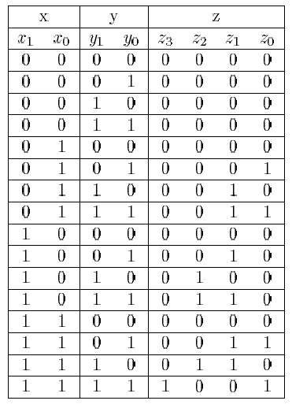
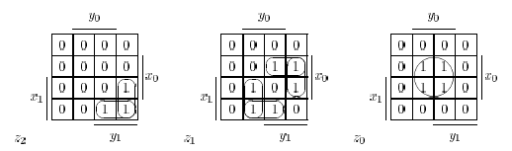
5.14 Design a minimal two-level NAND network that computes the product of two integers, with input values from 0 to 3. Minimize each output expression separately.
z3= x1x0y1y0
z2= x1x0’y1+x1y1y0’
z1= x1x0’y0+x0y1y0’+x1’x0y1+x1y1’y0
z0= x0y0

Slide 4
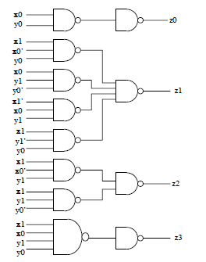

Slide 5
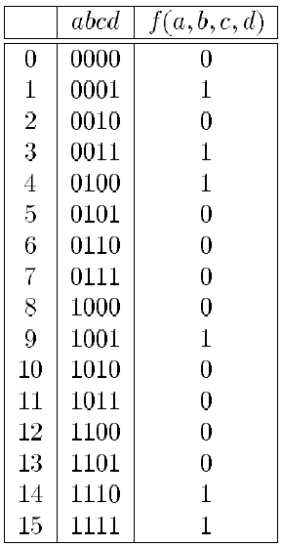


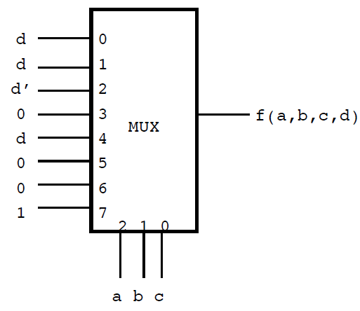
9.15 Implement f(a,b,c,d) = one-set(1,3,4,9,14,15)
(a) An eight-input Multiplexer

Slide 6
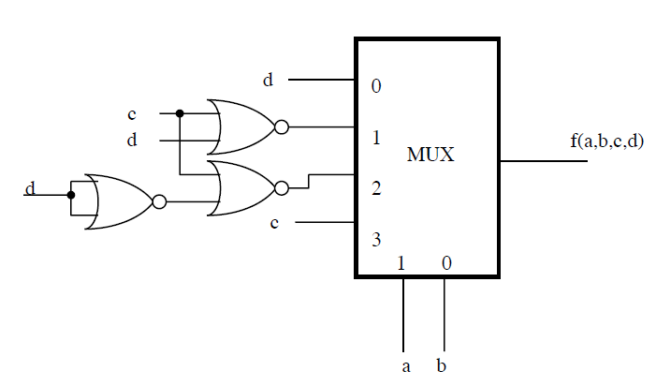
(b) A 4-input MUX and NOR gates
- using a and b as select inputs to the MUX

Slide 7
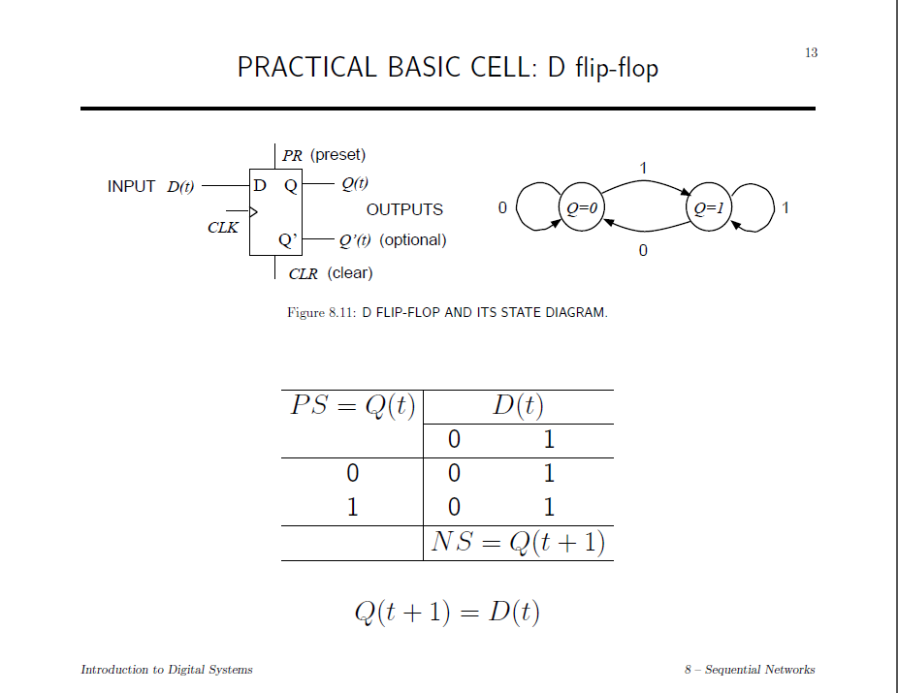

Slide 8
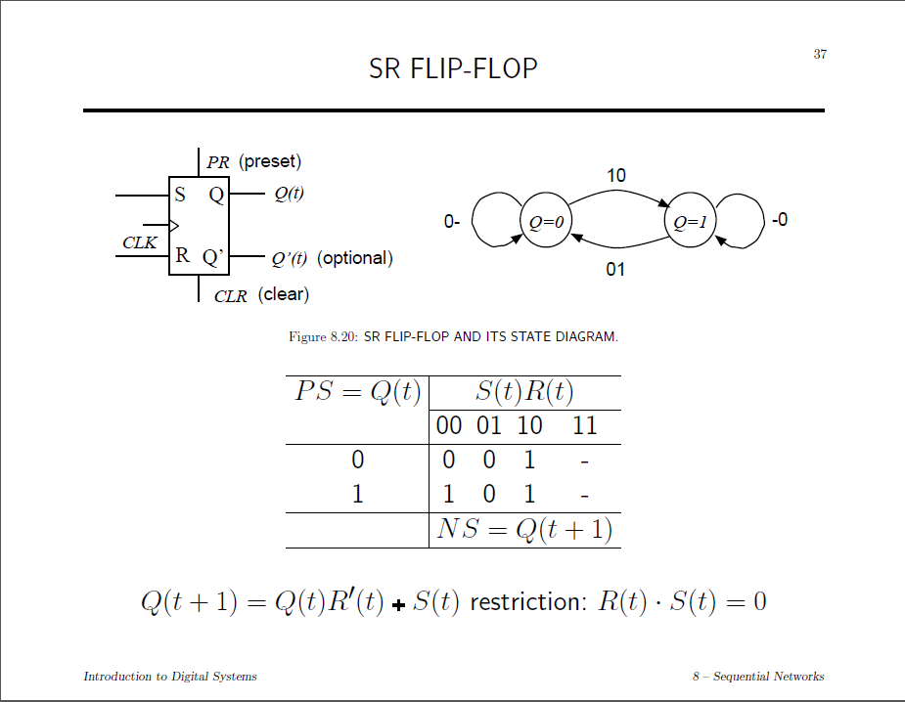

Slide 9
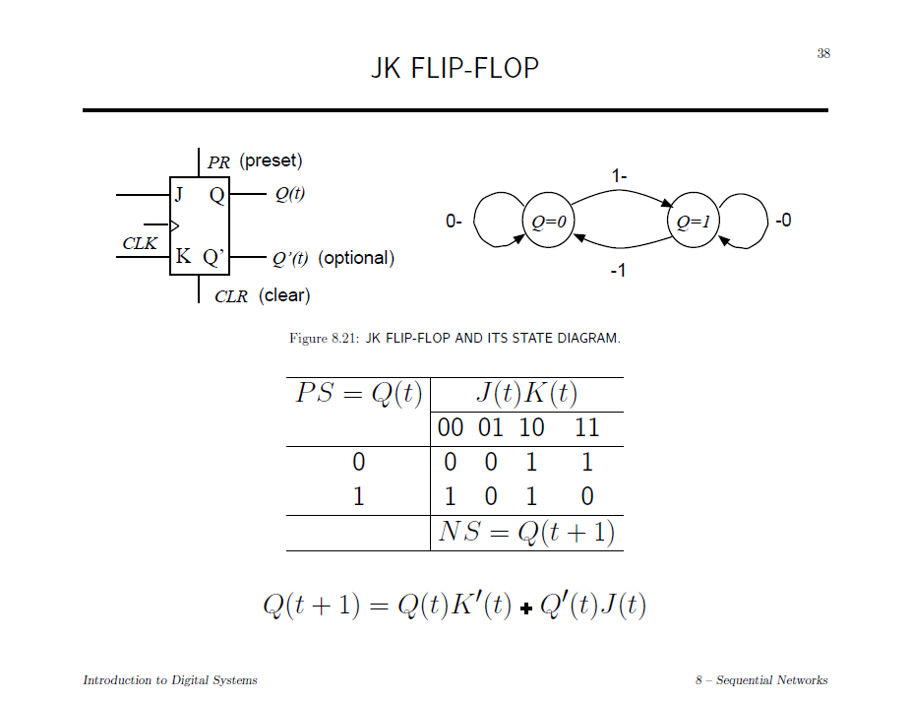

Slide 10
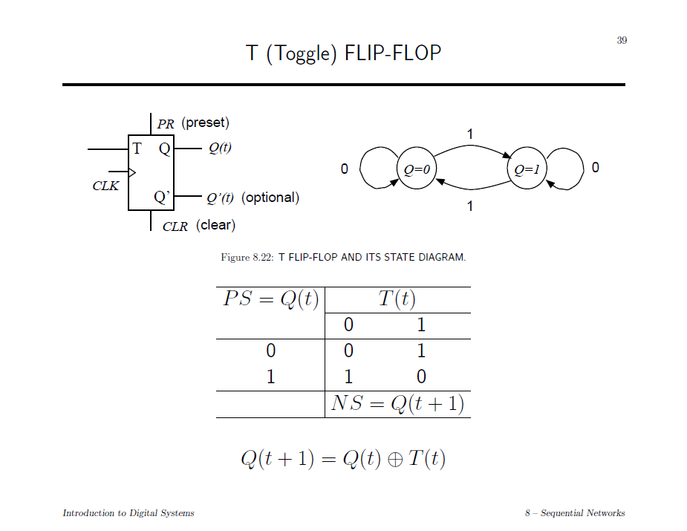

Slide 11
